Slide 1
Doctor Visit Analysis
Presented by:
Meghanath

Slide 2


PAGE 02
Analyzing Doctor Visit Data to Gain Insights into Healthcare Patterns and Patient Behavior

Slide 3

PAGE 01
Name Email ID
College Name
: Batturi Meghanath
: meghanath31703@gmail.com
: Mahatma Gandhi Institute of Technology
College State : Telangana
Intership domain :Data analytics
Duration :5-6-2023 to 13-7-2023

Slide 4
PAGE 03
1)Introduction 2)Data overview 3)Details about the end user
My solution
My customizations
project modelling 7)Results

Slide 5
PAGE 04
This project aims to gain valuable insights into healthcare patterns and patient behaviors by analyzing a dataset containing information about doctor visits. The dataset includes attributes such as gender, age, income, illness, payment options, and chronic conditions.
Various data visualization techniques, such as bar charts, histograms, scatter plots, and pie charts, are employed to present the data effectively.

Slide 6



PAGE 05
Healthcare Providers and Facilities
Healthcare Administrators and Policy Makers
Public Health Organizations
Health Insurance Companies
Medical Researchers
Pharmaceutical Companies
Academic Institutions

Slide 7

PAGE 06
The analysis of doctor visit data provides a comprehensive understanding of healthcare utilization, patient demographics, prevalent illnesses, and the impact of chronic conditions. It offers actionable insights that can inform decision- making and improve healthcare services across various sectors.
o Resource Optimization
o Research and Innovation
o Improved Patient Care

Slide 8

PAGE 07
Understanding the context of the dataset was crucial.
To ensure data quality and accuracy, data cleaning and preprocessing were performed.
This involved handling missing values,
addressing outliers, and transforming the data into a suitable format for analysis.
visualization techniques was tailored to the attributes and objectives of the analysis.
Different types of charts, such as bar charts,
histograms, scatter plots, and pie charts, were selected to effectively represent the data and reveal patterns and relationships.

Slide 9


PAGE 08
Utilized descriptive statistics and data visualization techniques to summarize and understand the dataset's main characteristics and patterns.
Cleaning and transforming the data to handle missing values, outliers, and prepare it for analysis.
Utilized Python and its popular libraries (e.g., Pandas, NumPy, Matplotlib, Seaborn) to conduct data manipulation, visualization, and modeling tasks.

Slide 10
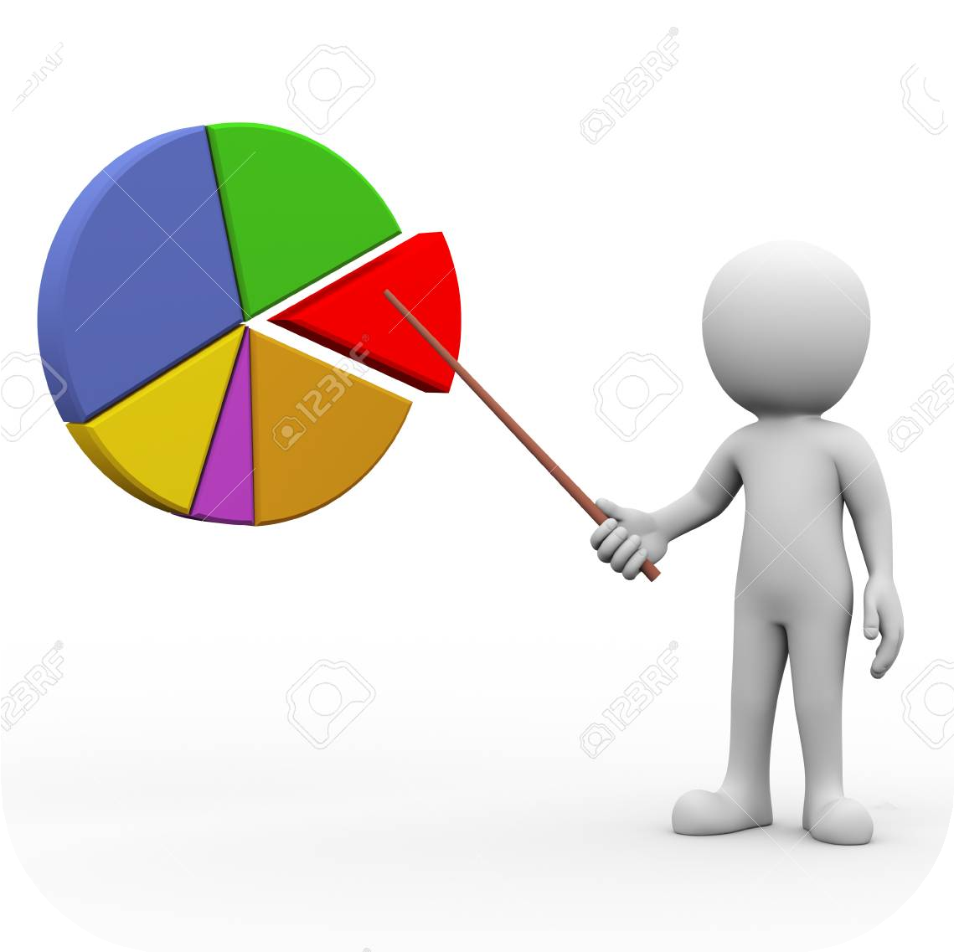
Gender Distribution:
PAGE 09
The dataset shows that female patients have a slightly higher number of doctor visits compared to male patients
Age Distribution:
The analysis reveals that the majority of doctor visits are made by patients in the age less than 30 and greater than 60 years, indicating a higher healthcare demand in this age range.
Income Analysis:
Patients with average income levels tend to have more frequent doctor visits, suggesting a correlation between income and healthcare utilization.
Illness Breakdown:
The majority of patients who have visited the doctor are affected by type 1 disease with 31.6% , followed by the type 0 with 29.9% of patients.
Chronic conditions:
Patients with long-term chronic conditions tend to have more doctor visits compared to patients with non-chronic conditions.
Insurance Analysis:
The majority of patients have private insurance whereas only few hold the beneﬁt of insurance provided by the government.

Slide 11
PAGE 10
My Github :
https:/ github.com/m4maggi Project Repository:
https:/ github.com/m4maggi/Doctor-visit-analysis.git

